Slide 1

NATIONAL INSTITUTE OF TECHNOLOGY, CALICUT
Presented By: Kaushik Kumar Giri Shubhanshu Rai Boda Rakesh.
Guided By: Neethu Manikantan

Slide 2

ONLINE Auction Site

Slide 3
overview
01
02
Problem
Solution
03
04
Technology Stack
Scope of Auction site

Slide 4
overview
05
06
Product feature
Functionalities
07
08
Future plan
conclusion

Slide 5
Problem
01
On a daily basis we recieve many spam mails regarding buy and sell the product.

Slide 6
Solution
02
An online auction site project that holds online auctions of various product on a website and serves sellers and bidders accordingly.
The system design to allow user to set up their products for auctions and bidders to register and bid for various products available for bidding

Slide 7
Technology Stack
03
NETBEANS : JAVA SWING
DATABASE : MySQL

Slide 8
Scope of Auction Site
04
holds online auctions of various products on a website and serves sellers and bidders accordingly.

Slide 9
Features and Functionalities
05
Seller and Bidder can register
Seller can post and update the product
Seller can see the bidding history and final winner details
Bidder can bid the product
Bidder can check whether he is winner or not
Both Bidder and Seller can update their profile
Admin can manage the category and subcategory
Admin can verify the product

Slide 10
Product features
06

Slide 11
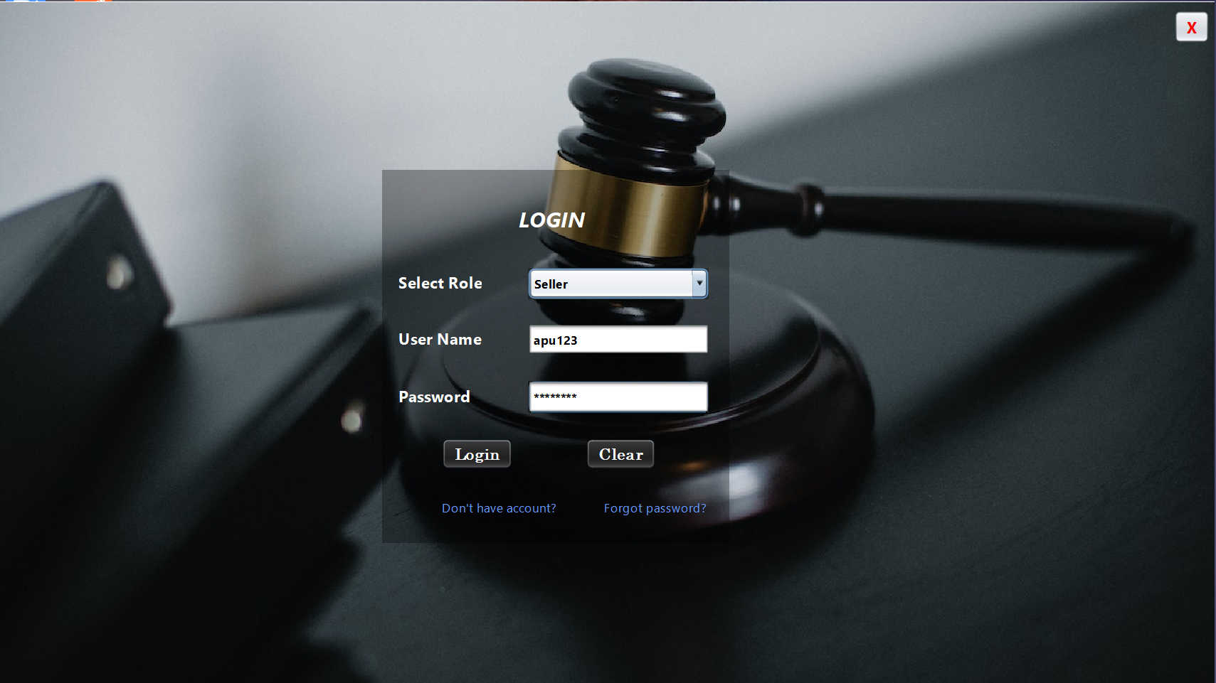
Login page
This is the Login Page for users ( Admin, Seller, Bidder). Users can enter their valid login credentials and can have access to their account.
Here signup and forgot password option is available only for Seller and Bidder.

Slide 12
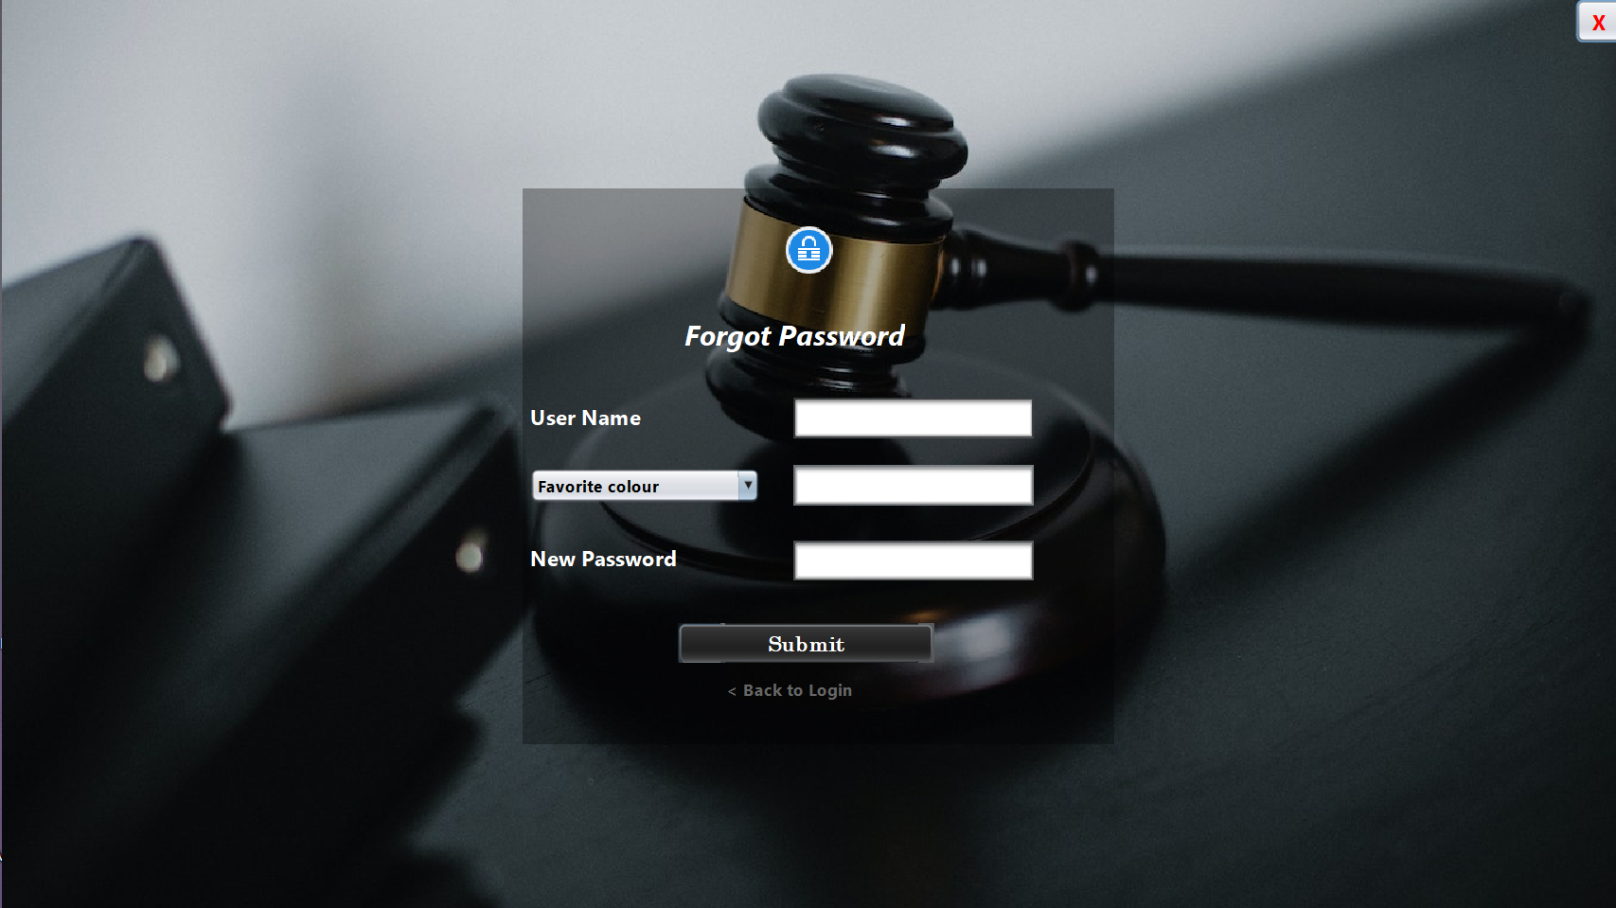
Forgot password
Here User can reset his/her password

Slide 13
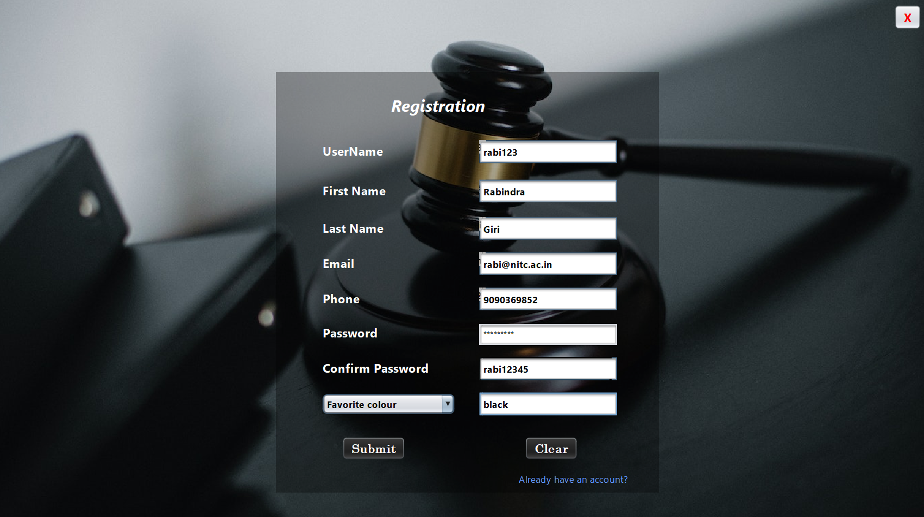
Registration page
This page provides option to student to register themselves with valid nitc email id.

Slide 14
Features for Seller
Update profile
Sell product
View product
Update product
Bidding history
View winner details
Seller can update profile
Seller can sell the product
Seller can view his/her own product
Seller can update the session end time
Seller can see bidding history of his/her own product
Seller can contact with winner to sell the product

Slide 15
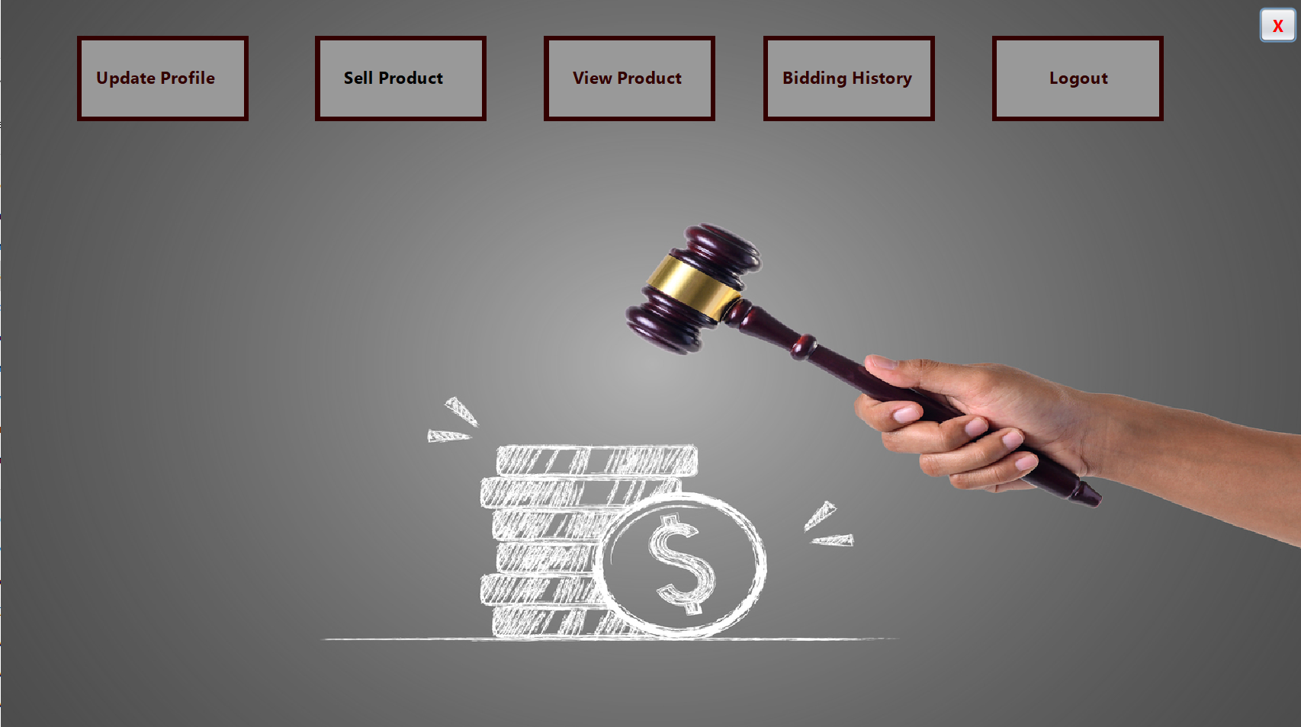
Seller Dashboard

Slide 16
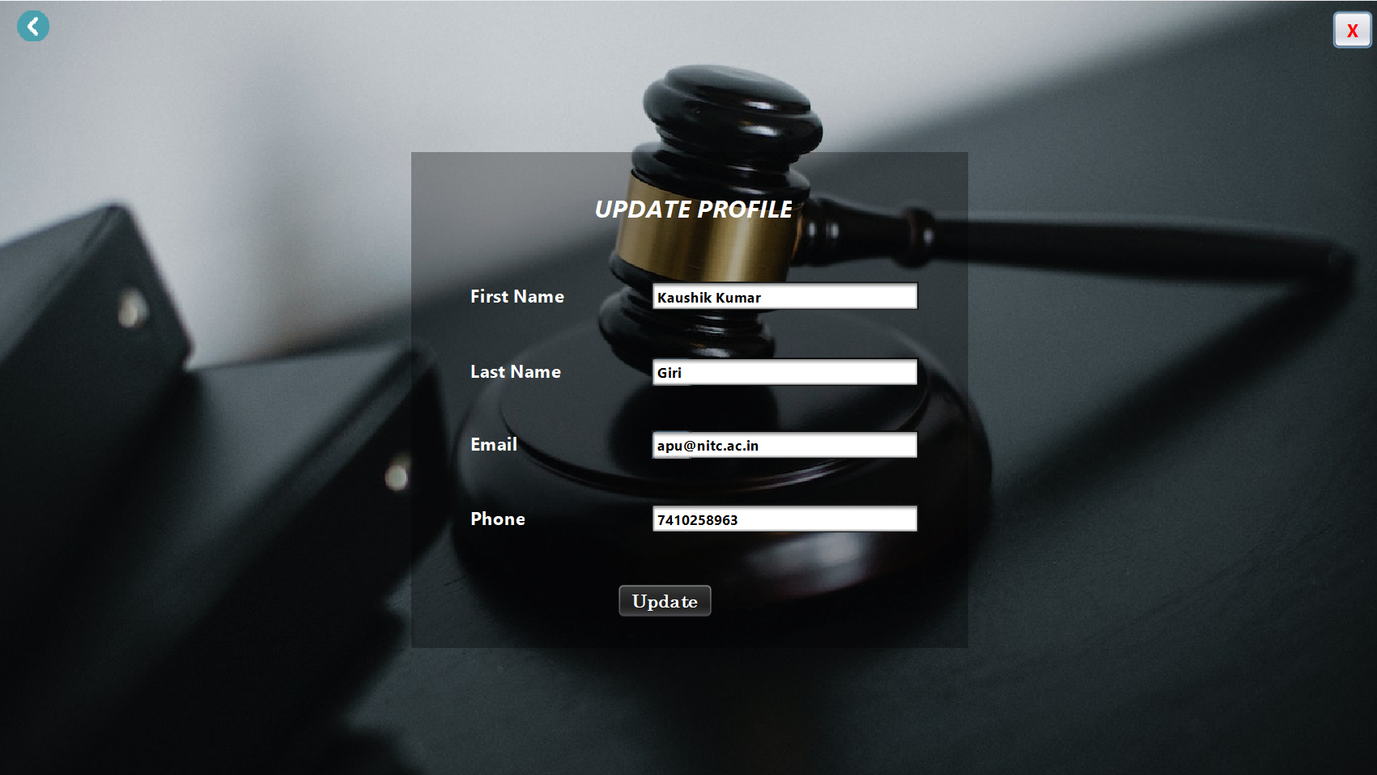
update profile

Slide 17
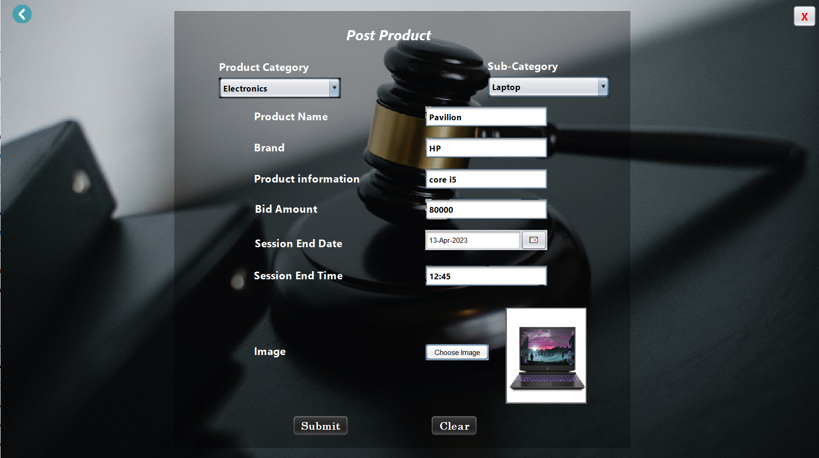
Sell product

Slide 18
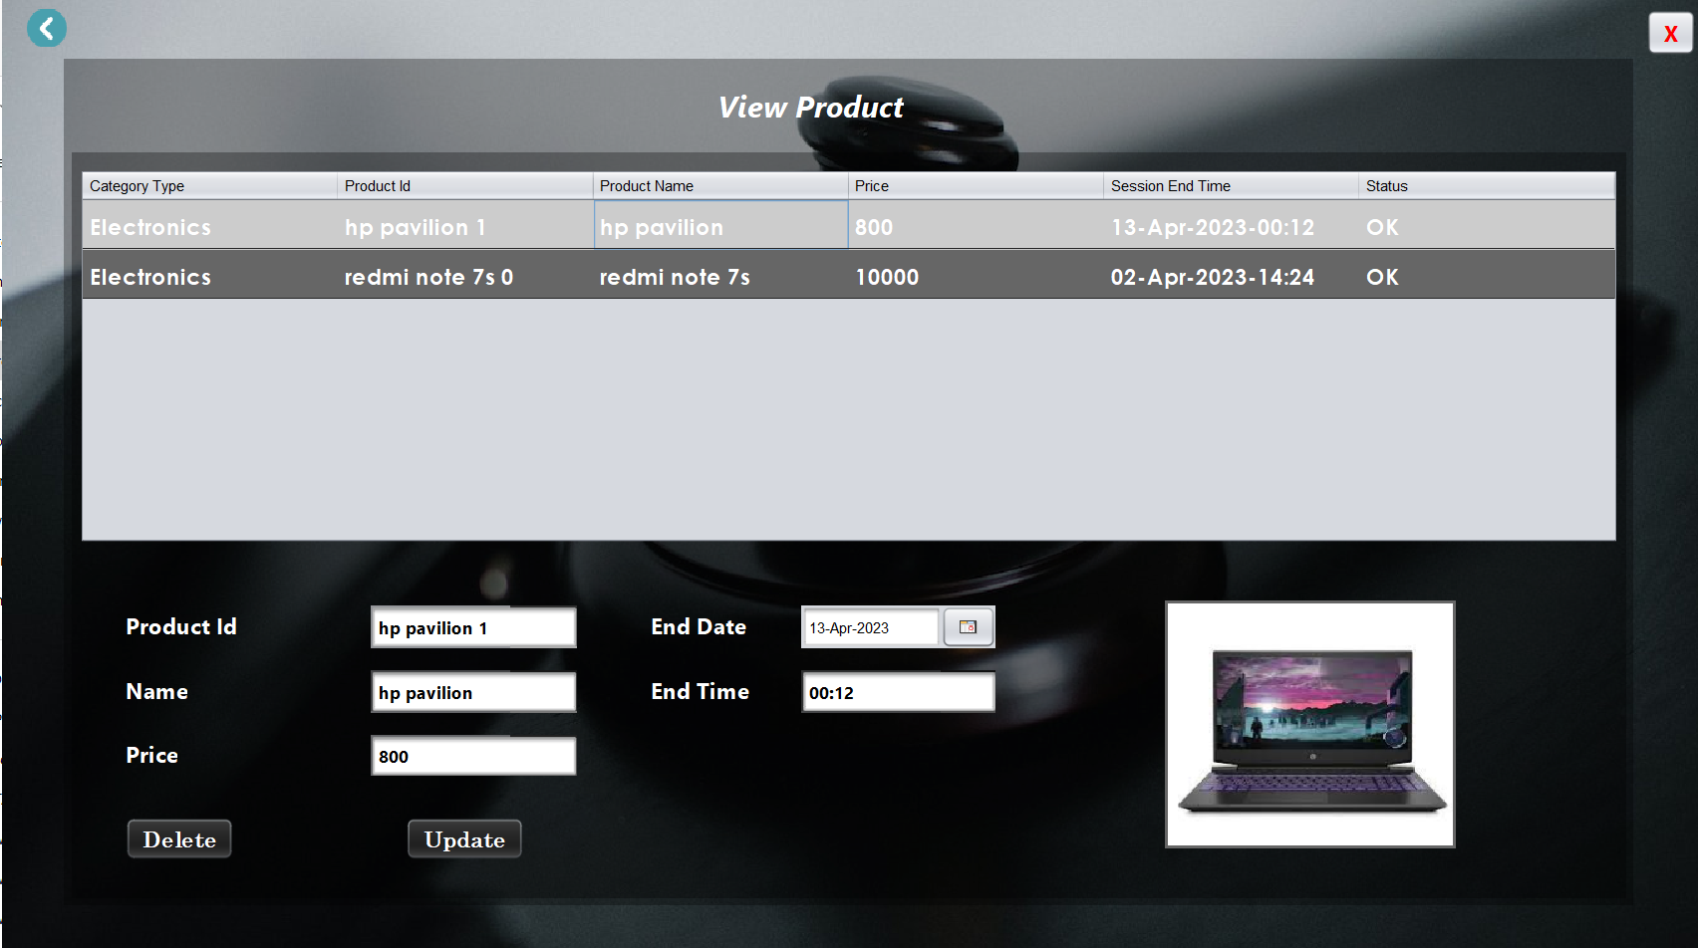
view and update product

Slide 19
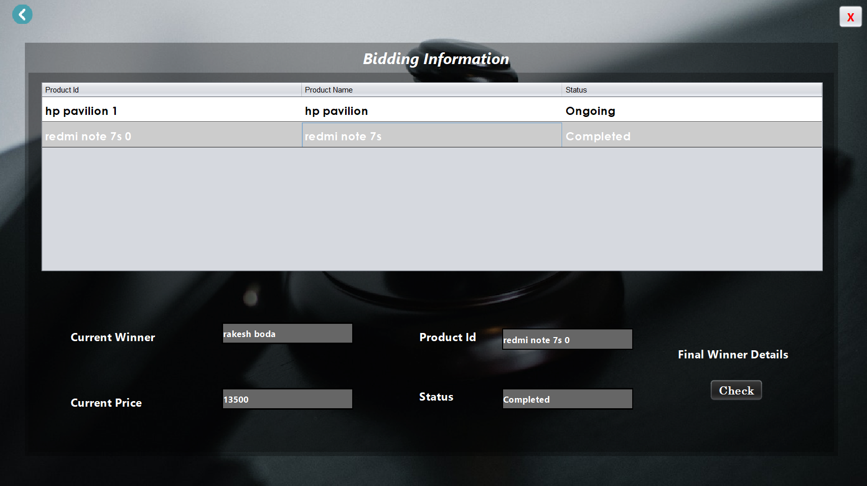
Bidding history

Slide 20
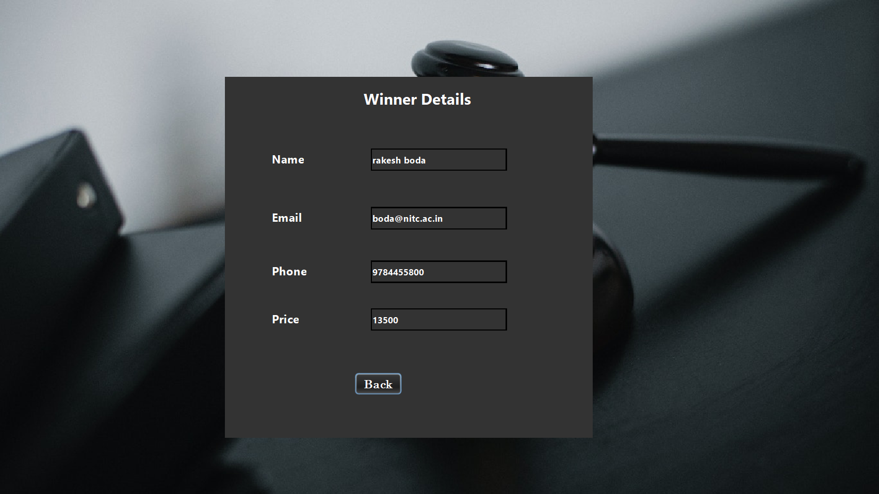
View winner details

Slide 21
Features for Bidder
Bid product
Check winner
Update profile
Bidder can update his/her profile
Bidder can bid the live product
Bidder can check whether he is winner or not

Slide 22
update profile

Slide 23
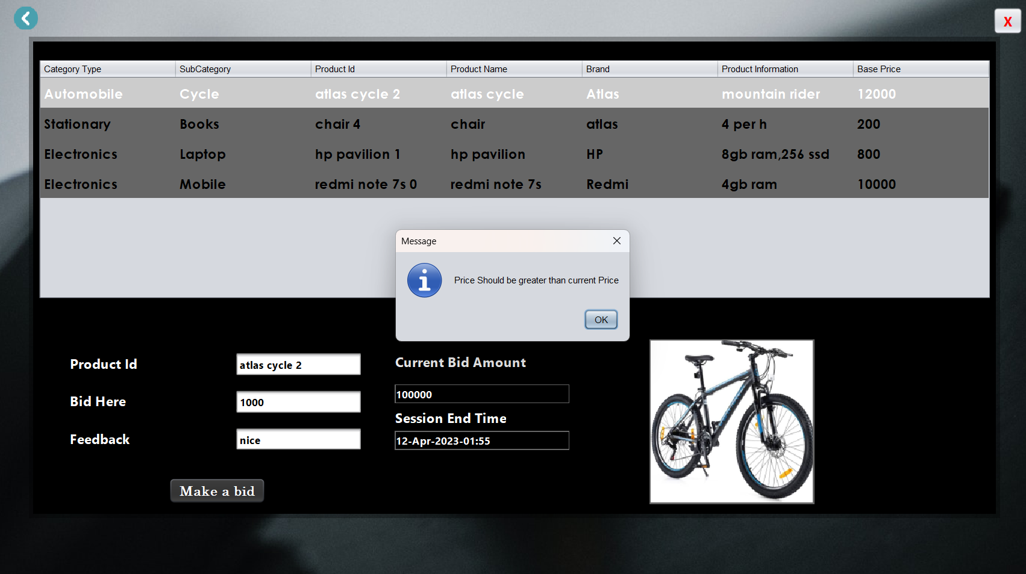
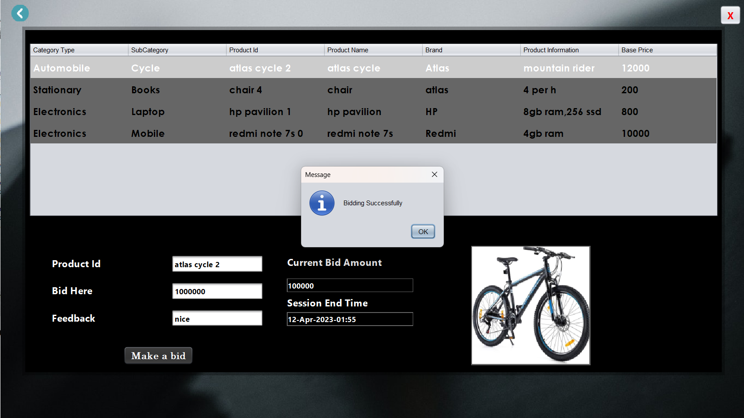
Bid for product

Slide 24
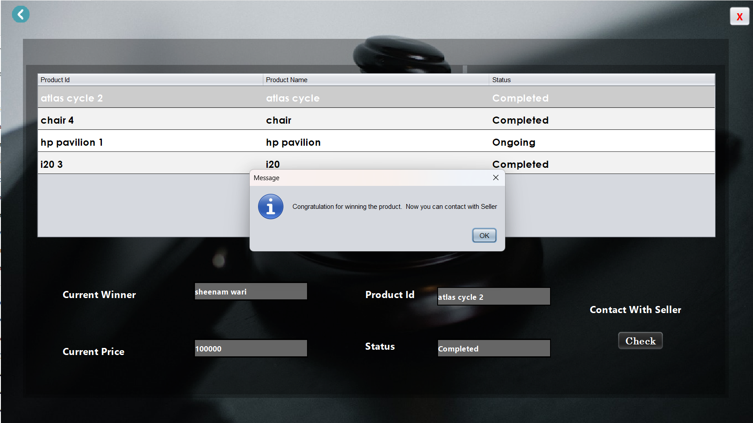
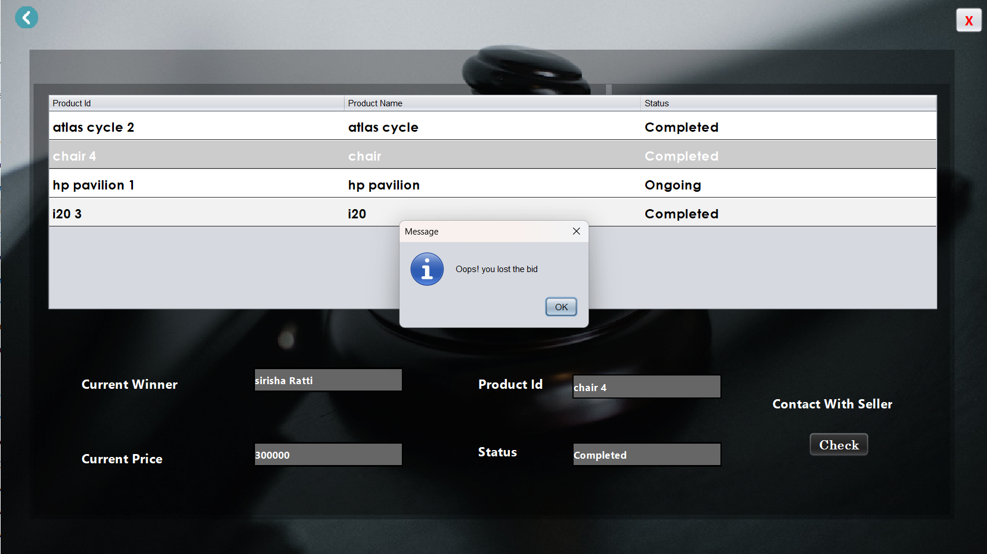
check winner

Slide 25
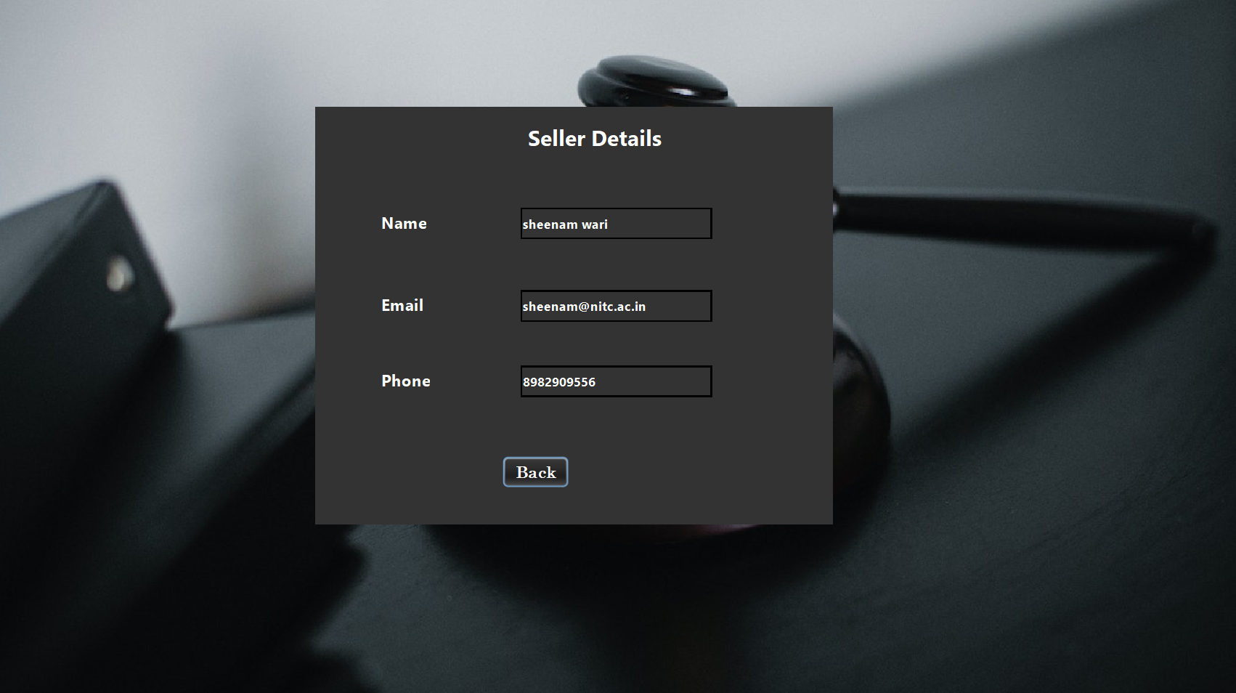
Seller details

Slide 26
Features for Admin
Manage subcategory
Verify product
Manage category
Admin can add,update or delete the category
Admin can add , update or delete the subcategory
Admin can check the product details is right or wrong and the verify it

Slide 27
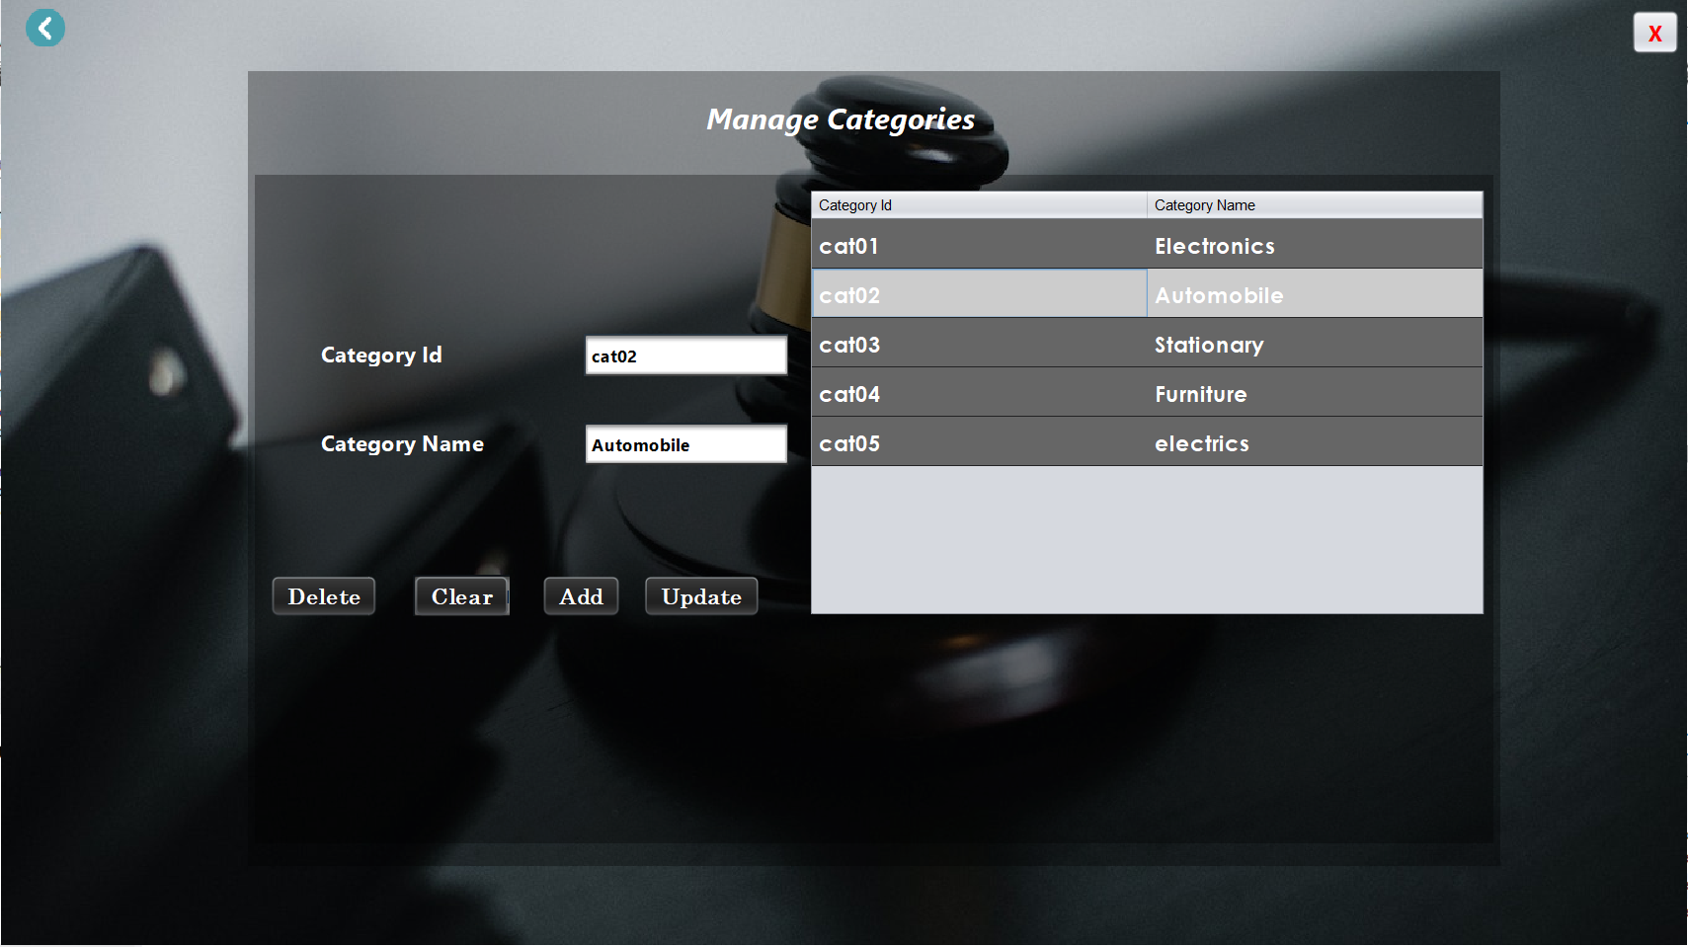
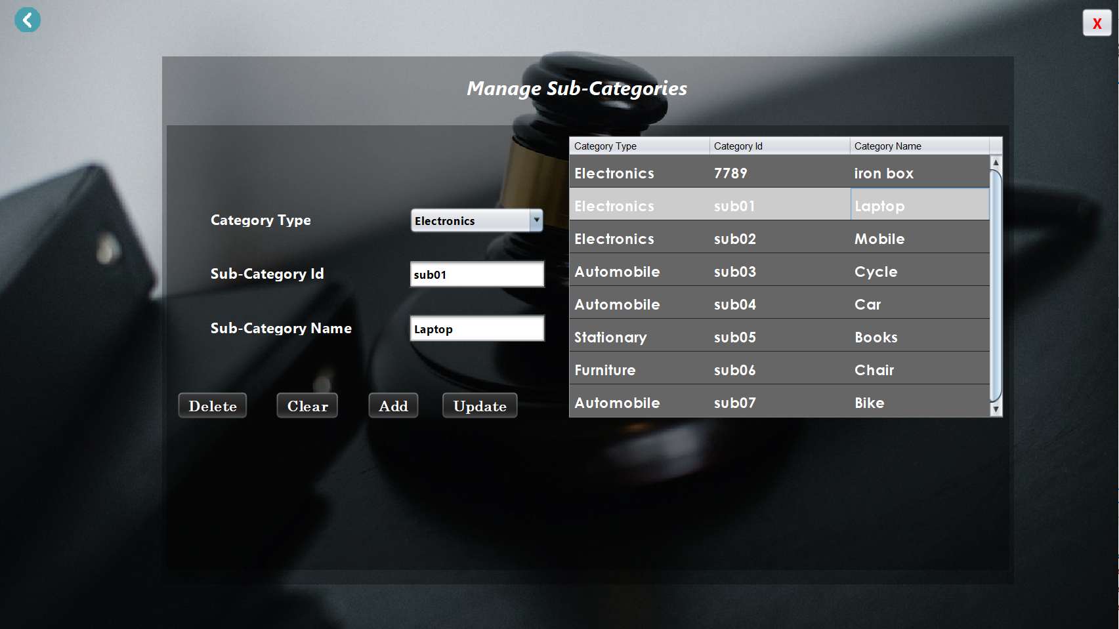
Manage category and subcategory

Slide 28
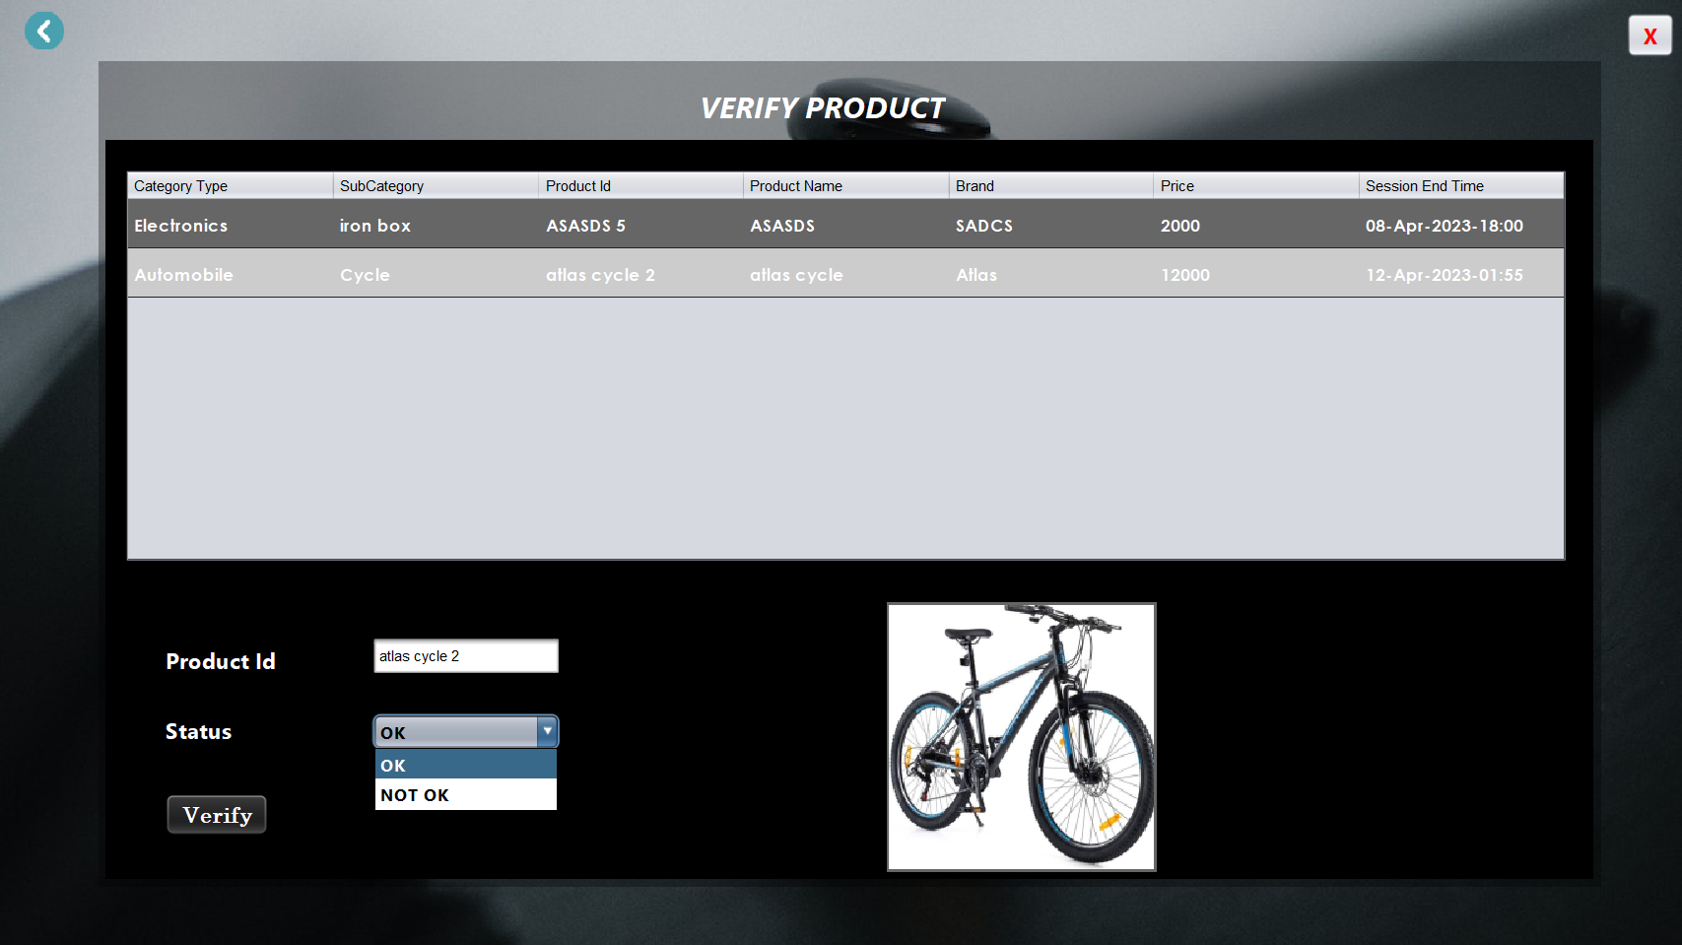
verify product

Slide 29
Future plan
07
Several Payment option(Credit/Debit card and UPI)
Mobile no. verification using OTP

Slide 30
Conclusion
08
An auction sale is a public sale. The goods are sold to all members of the public at large who are assembled in one place for the auction.
Such interested buyers are the bidders. The price they are offering for the goods is the bid
Happy Bidding

Slide 31
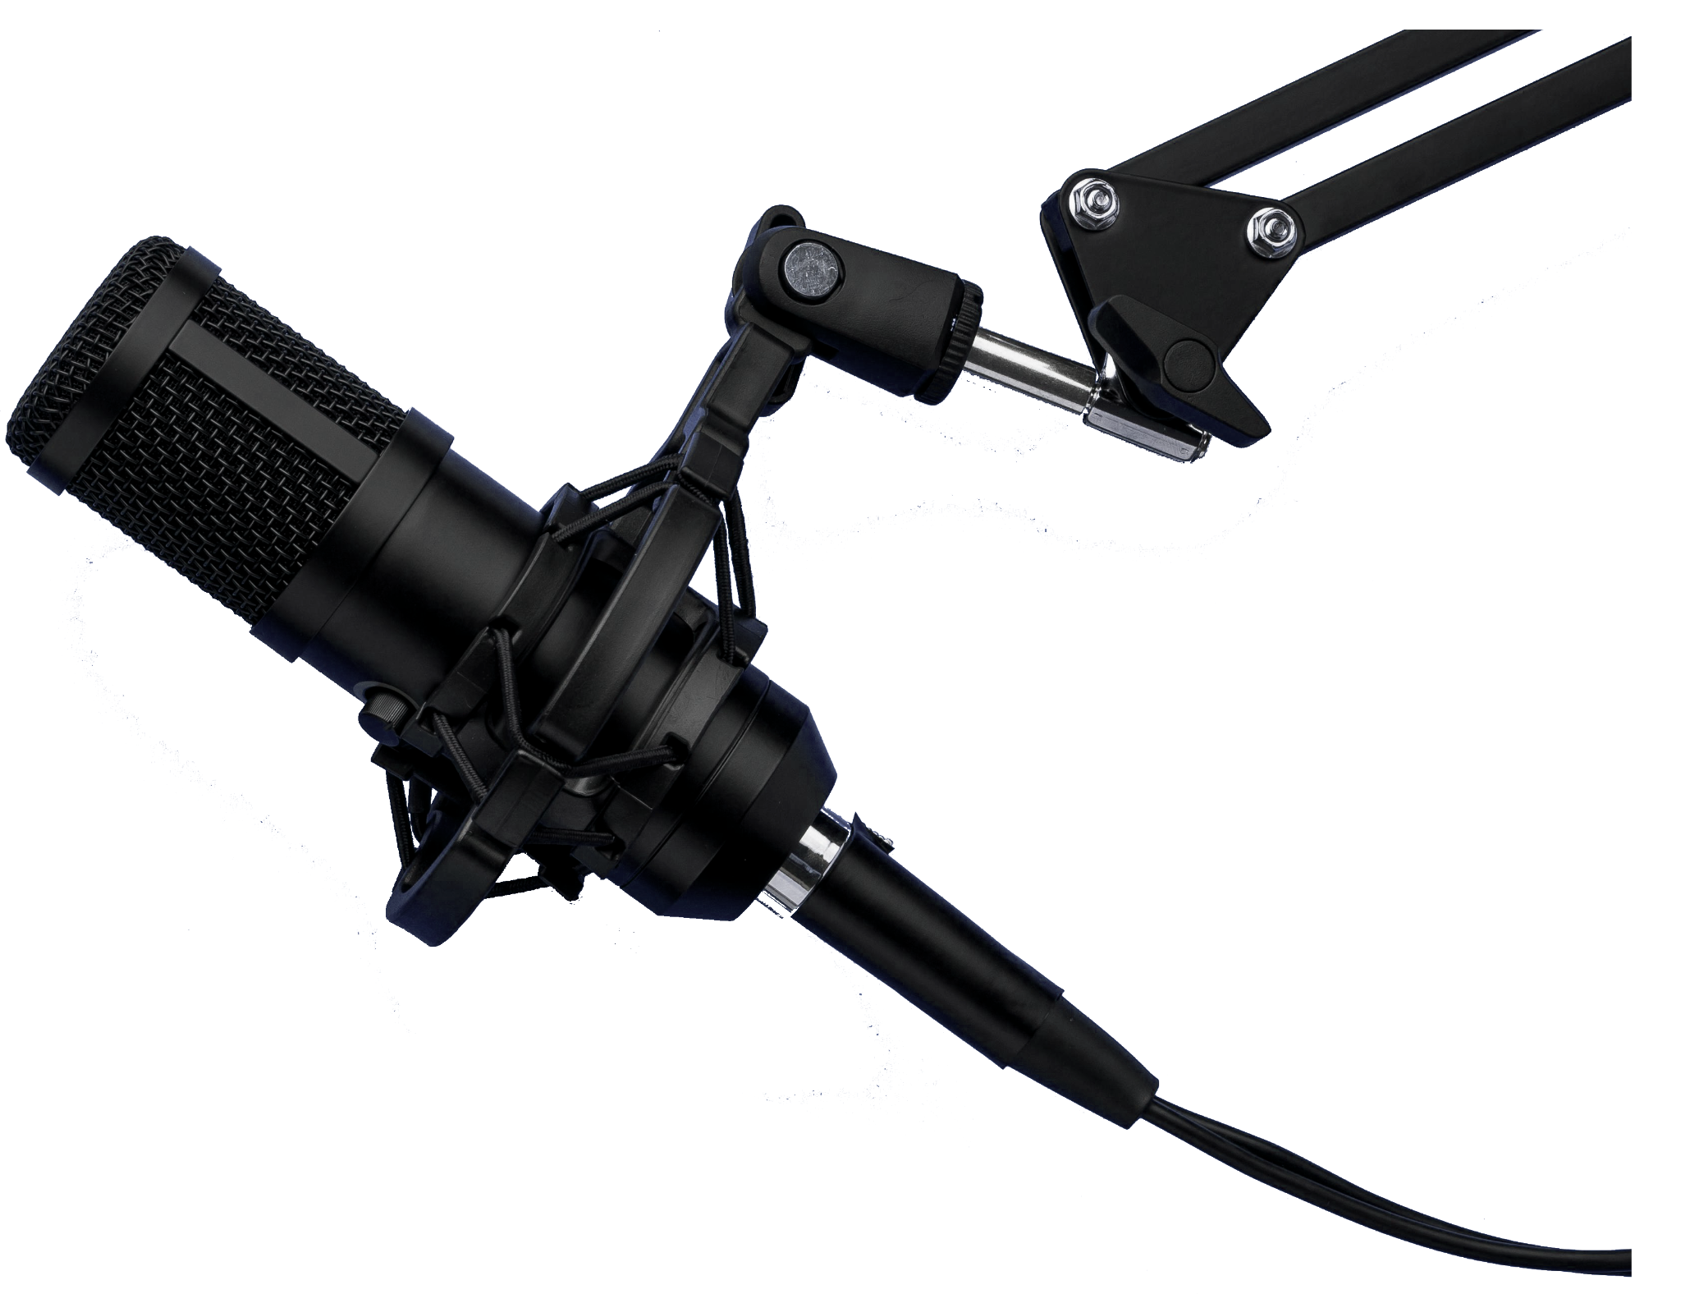


thanks!
Online Auction site

